Slide 1
Model-based RL
Dr. Prashant Aparajeya

Slide 2
What is a "Model" in RL?
A "model" (or environment model) typically consists of two main components:
Dynamics Model (P(s′∣s,a)): Predicts the next state s′ given the current state s and action a.
Reward Model (R(s,a) or R(s,a,s′)): Predicts the reward r received after taking action a in state s (and potentially transitioning to s′).

Slide 3
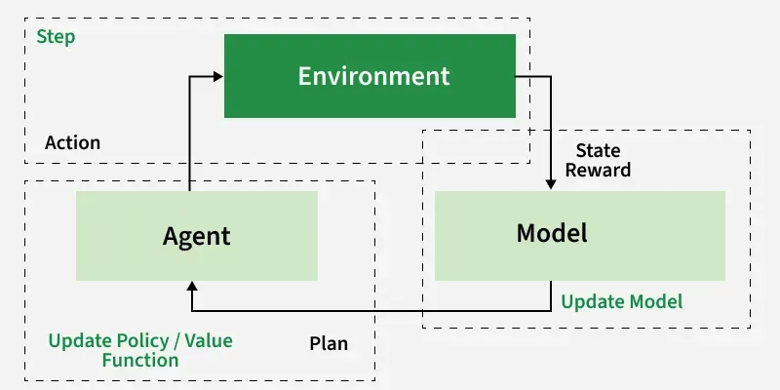

Slide 4
What is a "Model" in RL?
These models can be:
Known (given): If you have a perfect simulator or the exact equations of motion for a system (e.g., in a simple game or a control system with known physics).
Learned (approximated): More commonly in complex environments, the agent learns to approximate these models from its experiences with the real environment. This is where neural networks often come into play, forming a "learned simulator."

Slide 5
Step-by-Step Process
MBRL typically follows an iterative cycle, often involving three main phases:
Data Collection (Interacting with the Real Environment)
Model Learning (Building/Updating the Environment Model)
Planning / Policy Improvement (Using the Model)

Slide 6
Data Collection
Initial Exploration: The agent starts by taking actions in the real environment. Initially, these actions might be random or guided by a simple heuristic policy.
Collect Transitions: For each interaction, the agent records a transition tuple: (st​, at​, rt​, st+1​). This data represents how the environment actually behaves.
Store Data: These transitions are stored in a dataset or a replay buffer.

Slide 7
Model Learning
Train the Model: Using the collected data from Phase 1, the agent trains its environment model(s).
Dynamics Model: This is often a neural network that takes (st​, at​​) as input and tries to predict st+1​. The training objective is typically to minimize the prediction error (e.g., Mean Squared Error between predicted and actual st+1).
Reward Model: This could be another neural network that takes (st​, at​​) (or (st​, at​, st+1​)) and predicts rt​. The training objective is to minimize reward prediction error.
Iterative Refinement: As the agent collects more data from the real environment (in subsequent cycles), it continuously updates and refines its learned model. This is crucial because initial models will be imperfect.

Slide 8
Planning / Policy Improvement
Once the agent has a (potentially imperfect) model, it can use it to "imagine" future trajectories and improve its decision-making.
There are several ways to do this:
Model-Based Planning (e.g., Monte Carlo Tree Search, Dyna)
Model-Based Policy Learning (e.g., Value Iteration, Policy Optimization with Model-Generated Data)

Slide 9
Model-Based Planning
Uses the learned model to simulate future outcomes and evaluate actions, often without explicitly learning a policy network or value function first.
Simulate Trajectories
Evaluate Simulated Trajectories
Choose Best Action
Execute in Real Environment

Slide 10
Model-Based Planning
Simulate Trajectories: The agent uses its learned model to simulate many hypothetical "rollouts" or trajectories starting from the current state.
It picks an action, predicts the next state and reward using the model.
From that predicted state, it picks another action, predicts the next state and reward, and so on, for several steps into the future.

Slide 11
Model-Based Planning
Evaluate Simulated Trajectories: For each simulated trajectory, the agent calculates the total (discounted) reward.

Slide 12
Model-Based Planning
Choose Best Action: Based on these simulations, the agent determines the best action to take in the current real state.
Monte Carlo Tree Search (MCTS): A sophisticated planning algorithm that builds a search tree by simulating rollouts using the model, prioritizing paths that show promise. Used extensively in games like Go.
Dyna-style architectures: In Dyna-Q, for example, real experiences are used to update the Q-function and the model. Then, the model is used to generate many simulated experiences, which are also used to update the Q-function. This greatly accelerates learning by leveraging simulated data.

Slide 13
Model-Based Planning
Execute in Real Environment: The chosen action is then executed in the actual environment.

Slide 14
Model-Based Policy Learning
Uses the model to generate synthetic data or to train a separate policy/value network.
Generate Synthetic Data: The agent uses its model to generate a large amount of "imagined" (synthetic) transitions: (s,a,r,s′).
Train Model-Free Algorithm: This synthetic data is then fed into a standard model-free RL algorithm (like Q-learning, Policy Gradients, SAC, PPO, etc.) to train a policy network (π) or a value function (V or Q).
Iterative Training: The model-free algorithm trains on this imagined data, improving its policy or value function.
Execute in Real Environment: The policy learned from the model-generated data is then used to act in the real environment.

Slide 15
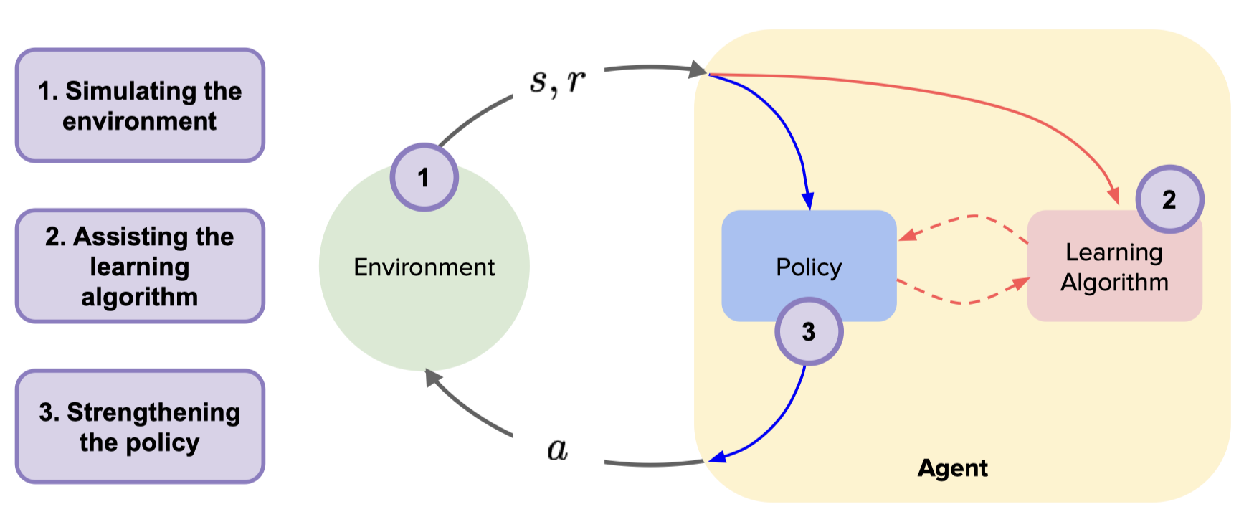

Slide 16
The Cycle Continues
The Loop:
After executing an action in the real environment (from Phase 3) the agent observes the true st+1​ and rt​.
This new real experience is then added to the dataset (back to Phase 1)
to further refine the environment model in Phase 2,
leading to better planning/policy in Phase 3.
This iterative loop allows the agent to continuously improve its model and, consequently, its policy.

